Slide 1
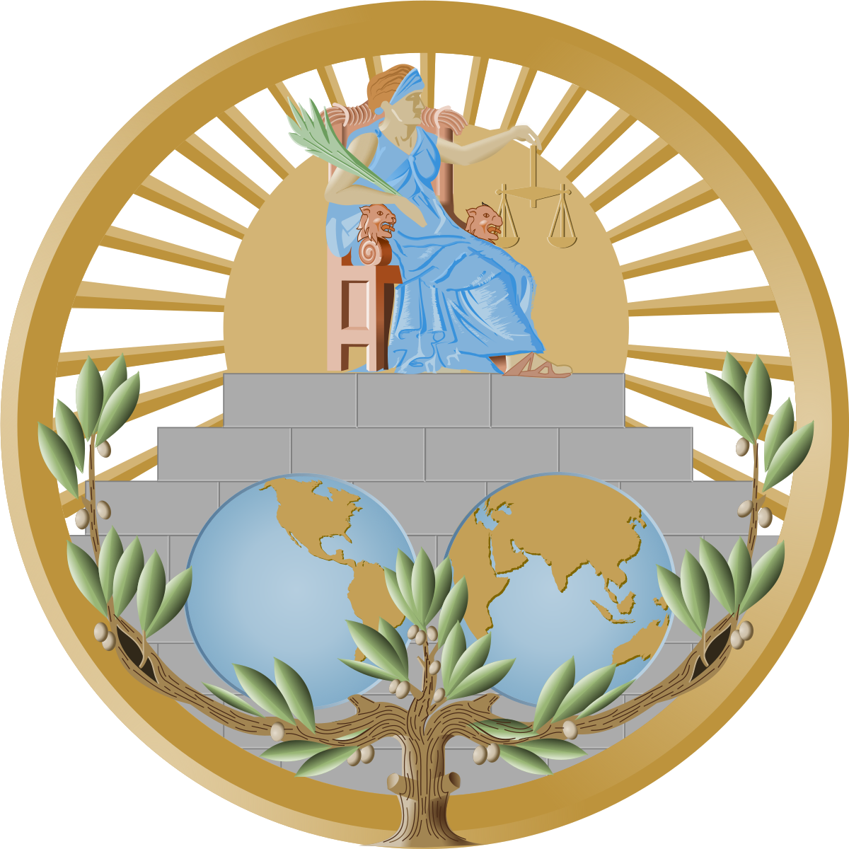
International Court of Justice

Slide 2
Table of Contents
Letter from the Chair
Introduction to the Committee
Topic 1: Allegations of Genocide under the Convention on the Prevention and Punishment of the Crime of Genocide (Ukraine v. Russian Federation)
Introduction
Explanation of the Problem
Focus of the Debate
Questions to Consider
Recommended Readings
Bibliography
Topic 2: Certain Iranian Assets (Islamic Republic of Iran v. United States of America)
Introduction
Explanation of the Problem
Focus of the Debate
Questions to Consider
Recommended Readings
Bibliography

Slide 3
LETTER FROM THE CHAIR
Dear Delegates,
Welcome to WINMUN 2023!
It gives us immense pride to serve as the Executive Board of The International Court of Justice at The Winchester Model United Nations. We are eagerly looking forward to the three extraordinary days of the forum that we will spend in committee alongside addressing and analysing two crucial problems.
We anticipate participants who value each other's viewpoints and work more towards a healthy debate as you will be representing portfolios in the International Court of Justice. As Judges and Advocates, you are expected to debate and reach balanced conclusions on the issues at hand: the Russia-Ukraine conflict and the US-Iran conflict. Alike bodies such as the general assembly or the security council, the ICJ has its own sequence of procedures and regulations.
As committee chairs, we will try and keep the committee running smoothly and expect the same from you all. We shall assist you to understand the parliamentary procedure and to guarantee that the opinions of all members are valued and heard. To ensure professionalism and multilateralism, we ask that you review and start practising the Rules of Procedure. We hope to meet you all at the conference and wish you the best of luck! Please contact us if you have any questions or need more information!
Regards,
Toshith Bhaumik and Shekeena Devmi
Chair and Co-Chair of the International Court of Justice

Slide 4
INTRODUCTION TO THE COMMITTEE
The International Court of Justice was formed based on the UN Charter in 1945 with the main aim of settling disputes with regard to International Law. The International Court of Justice is one of the United Nations' six main organisations, and it oversees all judicial cases involving the UN and its member nations. It essentially handles two tasks: resolving contested disputes and offering information and advice.
Controversial cases involve infringements of international treaties or conventions, and they usually involve two or more countries. The court's rulings are irrevocable, and every nation must abide by them without the option of appealing. Based on the General List, The International Court of Justice has heard nearly 183 cases.
Advisory opinions, on the other hand, are not legally obligatory in any way but represent the overall tendency of international law creation. These proposals have been thoroughly considered and are regarded as having "strong legal weight and moral authority".
We will be focusing on two contentious issues in these committee hearings, with two lawyers/advocates representing each country, as well as a panel of judges to consider and debate the facts and arguments presented. The International Court of Justice's Presidents will have complete authority over the committee and final verdict alongside the Judges vote.

Slide 5
Committee: International Court of Justice
Topic: Allegations of Genocide under the Convention on the Prevention and Punishment of the Crime of Genocide (Ukraine v. Russian Federation)
Author: Toshith Bhaumik
Introduction
The Soviet Union disintegrated in 1991, and the Russian Federation was declared as an independent country. Various provinces of the Soviet Union voted for independence and have subsequently split into multiple nations. Armenia, Kazakhstan, Uzbekistan, Tajikistan, and the biggest draw, Ukraine, are among the modern nations that gained independence from the Soviet Union.
The Budapest Memorandum, signed in 1994, consists of a series of political guarantees in which the government's promise to "respect Ukraine's independence, sovereignty, and existing boundaries." However, the interpretation of the security guarantees was purposefully kept uncertain. With the invasion of Crimea in 2014, the Russian Federation breached the Budapest Memorandum. The self-proclaimed Donetsk People's Republic (DPR) and Luhansk People's Republic (LPR) have been battling the Ukrainian governments since 2014. It has been claimed that the Russian minority in Ukrainian-controlled territories have been mistreated and harassed.
The Russian Federation is concerned that a number of previous Soviet Union entities have joined the North Atlantic Treaty Organisation (NATO). Russia has already had multiple diplomatic quarrels with the western world, the overwhelming majority of which are members of the European Union (EU) or the North Atlantic Treaty Organisation (NATO). On a worldwide scale, neither of these multinational coalitions took Russian interests and opinions into consideration. NATO and the EU are military allies as well as economic partners. Russia and Ukraine have had a number of small and major wars that have been mediated and resolved in the past. Russia claims that the western nations plotted this entire happening so that a station could be established in Ukraine, one of Russia's nearest neighbours. The Russian government further alleges that by creating these partnerships, the West is looking for a justification to send soldiers to Ukraine and attack the Russian Federation. Vladimir Putin, President of Russia, has blamed the Ukrainian government and indicated that this is certainly the prime reason why Ukraine is being given or willing to join such alliances.

Slide 6
Explanation of the Problem
Ukraine filed in the Registry of the Court an Application instituting proceedings against the Russian Federation concerning “a dispute . . . relating to the interpretation, application and fulfilment of the 1948 Convention on the Prevention and Punishment of the Crime of Genocide” (hereinafter the “Genocide Convention” or the “Convention”). In its Application, Ukraine contends that the Russian Federation has falsely claimed that acts of genocide have occurred in the Luhansk and Donetsk oblasts of Ukraine, recognized on that basis the so-called “Donetsk People’s Republic” and “Luhansk People’s Republic”, and then declared and implemented a “special military operation” against Ukraine with the express purpose of preventing and punishing purported acts of genocide that have no basis in fact. Ukraine emphatically denies that any such genocide has occurred.
Russian military operations close to Ukraine's borders resumed in October 2021, intensifying fears of an impending invasion. Army, missiles, and other heavy weaponry were identified moving into Ukraine towards the end of 2021 for little or no explicable reason, as per commercial aerial surveillance, social media posts, and publicly available data. On February 24, 2022, Vladimir Putin began a large-scale military operation in Ukraine. According to the UN, around seven million people have been forcefully relocated as a consequence of the war, and approximately three thousand civilians have died. The violence has displaced five million additional Ukrainians, with the bulk fleeing to Poland, a NATO member where the US and other allies are assisting with the refugee surge. By April 6, all Russian forces had left the area around Kyiv. In addition to Russia's pullout from Kyiv, Ukrainians have alleged Russian forces of harassment, maltreatment, and even committing crimes against humanity. These reports described extrajudicial killings.
Russia's leader, Vladimir Putin, initially planned to invade Ukraine, overturn its government, and put a stop to Ukraine's aspirations to join NATO. After a month of setbacks, he abandoned his attempt to take over the Ukrainian capital of Kyiv and moved his concentration to the nation's east and south regions. When he launched the attack on February 24, he stated his desire to "demilitarise and de-Nazify Ukraine.". His declared purpose was to protect individuals he said had been victims of the Ukrainian government's eight-year campaign of tyranny and genocide. Keeping Ukraine impartial was quickly added as a new aim.
A few days before invading Ukraine, Vladimir Putin had extended his support to the Donetsk and Luhansk region recognizing them as independent states. The Zaporizhzhia territory in South-East Ukraine is historically known for the nuclear power plant and its disruption of power supplies. Towards the end of September, Russia formally annexed four regions of Ukraine - Donetsk, Luhansk, Kherson and Zaporizhzhia.

Slide 7
Focus of the Debate
Initiating legal action against the Russian Federation in connection with "a dispute.. relating to the interpretation, application and fulfillment of the 1948 Convention on the Prevention and Punishment of the Crime of Genocide" (hereinafter the "Genocide Convention" or the "Convention") was done by Ukraine in the court's registry. In its Application, Ukraine claims that the Russian Federation has falsely asserted that acts of genocide have taken place in the Ukrainian provinces of Luhansk and Donetsk, recognized those provinces as the "Donetsk People's Republic" and the "Luhansk People's Republic" based on those assertions, and then declared and carried out a "special military operation" against Ukraine with the express aim of stopping and punishing those alleged acts of genocide that have no basis Ukraine vehemently refutes the existence of any such atrocity.
In October 2021, Russian military actions in close proximity to Ukraine's borders started, escalating worries about an eventual invasion. According to commercial aerial surveillance, social media posts, and publicly available data, army, missiles, and other heavy armament were discovered flowing into Ukraine before the end of 2021 for little to no apparent cause. Vladimir Putin launched a significant military offensive in Ukraine on February 24, 2022. Around seven million people have been forcibly displaced as a result of the fighting, and almost three thousand civilians have perished, according to the UN. Five million more Ukrainians have been displaced by the bloodshed, the most of whom have fled to Poland, a NATO member where the US and other allies are supporting the influx of refugees. All Russian soldiers have left the region around Kiev by April 6. Ukrainians have accused Russian personnel of harassing, mistreatment, and possibly committing crimes against humanity in addition to Russia's withdrawal from Kyiv. These reports talked about extrajudicial executions.
Vladimir Putin, the president of Russia, initially intended to invade Ukraine, overthrow its government, and halt Ukraine's efforts to join NATO. He gave up trying to take over Kyiv as the capital of Ukraine after a month of failures and shifted his focus to the east and south of the country. On February 24, when he began the offensive, he declared his intention to "demilitarize and de-Nazify Ukraine." His stated goal was to defend people who, in his words, had been the targets of an eight-year campaign of oppression and genocide by the Ukrainian government. The objective of maintaining Ukraine's impartiality was swiftly added.
Vladimir Putin has pledged his support for the Donetsk and Luhansk area declaring them independent nations a few days prior to invading Ukraine. In the past, the nuclear power station in the Ukrainian region of Zaporizhzhia was notorious for disrupting electricity supply. Russia formally annexed Donetsk, Luhansk, Kherson, and Zaporizhzhia, four areas of Ukraine, around the end of September.

Slide 8
Questions to Consider
What is the Budapest Memorandum?
Why does Ukraine want to join NATO or the EU?
What did Russia blame Ukraine, the EU and NATO for?
What have been the effects of the so called “special military operation” on Ukraine by Russian Federation?
What is the geographical disadvantage for Russia when Ukraine joins any western dominance alliance like The North Atlantic Treaty Organisation?
History of Druzhba Pipeline
How can pro-supporters be influenced to become mediators instead and give up the idea of supporting the conflict?
How do economic sanctions placed on Russia assist Ukraine?
How and Why is the West assisting Ukraine with arms and equipment?
Why can Russia easily annex regions in Eastern Ukraine?
What humanitarian assistance and rehabilitation services can be provided to the inhabitants living near the areas of conflict?

Slide 9
Recommended Readings & Bibliography
https://www.icj-cij.org/en/case/182
https://www.cnbc.com/2022/01/27/how-russia-invaded-ukraine-in-2014-and-how-the-markets-tanked.html
https://www.cnbc.com/2022/03/15/russia-and-ukraine-talks-a-guide-to-the-demands-and-the-red-lines.html
https://www.bbc.com/news/world-europe-56720589.
https://www.wsj.com/articles/helping-ukraine-win-is-a-vital-nato-interest-russia-putin-donbas-natural-gas-missile-attack-war-invasion-11650036249
https://www.brookings.edu/blog/order-from-chaos/2022/03/10/russia-vs-ukraine-how-does-this-end/
https://oec.world/en/profile/bilateral-country/ukr/partner/rus?redirect=true.
https://www.reuters.com/world/kremlin-says-russian-military-action-will-stop-moment-if-ukraine-meets-2022-03-07/.

Slide 10
Committee: International Court of Justice
Topic: Certain Iranian Assets (Islamic Republic of Iran v. United States of America)
Author: Shekeena Devmi
Introduction
Political relations between Iran and The United States of America initiated when Iran’s first ambassador was dispatched to Washington DC in 1856 followed by the US sending their first ambassador to Iran in 1883. This led to the establishment of formal ambassador relations between the two countries in 1944. During 1953 , the United States' CIA had assisted in the 1953 coup d’etat that caused the eradication of the government of Iranian prime minister Mohammed Mossadeq, inducing the “deeply anti-American character” of the 1979 Iranian revolution.
Concurrent to the 1953 coup, the Abadan crisis arises from 1951-1954. Iran nationalized the Iranian assets in Anglo-Iranian Oil Company (AIOC) , which was controlled by Britain’s multinational oil and gas company , BP p.l.c. Iran expelled Western companies from Oil refineries in the city of Abadan. This resulted The United States facing the loss of significant crude oil supplies and refined products for a period of time. However under the pressure enforced by both US and UK, Iran signed the consortium agreement of 1954.
Soon after, in 1957 , the “Atoms for Peace Program” was initiated. The United States and Iran signed the Cooperation Concerning Civil Uses of Atoms agreement. Iran benefited from receiving nuclear education and technology from the United States , laying the foundation for the country’s nuclear program. Soon after the birth of OPEC (Organization of the Petroleum Exporting Countries) in 1960 made Iran an even more crucial ally to the United States.
However during 1979, the Iranian revolution commenced. The US had faced the “Iranian Hostage Crisis” , which resulted in Washington severing ties with Tehran, sanctioning Iranian oil imports and freezing Iranian assets. This was followed by events such as Iran’s Beirut Barracks Bombing, United States’ “Operation Praying Mantis” and more. After the 1979 hostage crisis, Iran and The United States have had no formal diplomatic relations. Instead, Pakistan serves as Iran’s protecting power in the US, while Switzerland serves as the protecting power of the US in Iran

Slide 11
Explanation of the Problem
Iran filed an application against The United States of America at The International Court of Justice on June 14 2016, asserting that The United States had taken measures against Iran and Iranian companies that amount to violations of the 1955 treaty of amity, economic relations, and consular relations. Iran seeks the unfreezing and return of nearly $2 billion in Iranian assets held in the US.
The application filed by Iran to the ICJ was a response to the United States Supreme Court’s April 2016 ruling in the Peterson V. Bank Markazi case. The suit involved over 1,300 individuals who had secured favorable verdicts in separate cases against Iran for its alleged role in the Beirut barracks bombings and other terrorism acts outside the US. Individuals sought out compensation through funds in the citibank account in New york connected with Iran’s central bank, Bank Markazi. In favor of Peterson, the court sanctioned the turnover of about $1.75 billion in Bank Markazi assets to satisfy court judgements in favor of terrorism victims under the foreign sovereign immunities Act terrorism exception.
For many years, the US has been firm with designating Iran as a state sponsoring terrorism, a designation which Iran strongly contests. On 9th March 2016, the US district court for the Southern District of New York penalized Iran for providing more than US$ 10.5 billion to families of people killed in 11 September 2001 terrorist attacks. Similarly, on 3rd July 2012, the US district court of Colombia stated that it had issued over US$ 8.8 billion in ruling against Iran regarding its alleged involvement in deaths of US marines killed in the bombing of their barracks in beirut. With various claims and enforcement proceedings as mentioned above, US courts sanctioned total damages of over US$ 30 billion against Iran over the country’s alleged involvement in various terrorism acts, mainly outside the geographic borders of the USA.
Since 2016, Iran argues that US has violated its obligations under the 1955 treaty of Amity by “...failing to recognize the separate juridical status of all iranian companies, unfair and inequitable treatment of such companies and their properties and applications of restrictions to such entity on the making of payments and other transfers of funds to or from the US”. Washington counters by stating that the funds in question were seized to compensate the victims of alleged Iran-supported terrorism.
The case states the dispute resolution clause in the treaty of amity clearly provided jurisdiction to the ICJ, rendering all preliminary objections of the US untenable.

Slide 12
Focus of the Debate
On June 14, 2016, Iran submitted a complaint to The International Court of Justice against The United States of America, claiming that the United States had taken actions against Iran and Iranian companies that amounted to violations of the 1955 treaty of amity, economic relations, and consular relations. Iran is requesting the unfreezing and return of over $2 billion in US-held Iranian assets.
Iran's application to the ICJ was made in response to the Peterson v. Bank Markazi decision rendered by the US Supreme Court in April 2016. The lawsuit involved more than 1,300 people who had won favorable judgments against Iran in different lawsuits relating to its alleged involvement in the Beirut barracks bombings and other acts of terrorism outside the US. People who had money in the New York Citibank account linked to Bank Markazi, Iran's central bank, demanded reimbursement. In Peterson's favor, the court authorized the sale of approximately $1.75 billion in Bank Markazi assets to pay court orders in favor of terrorism victims under the terrorism exception of the Foreign Sovereign Immunities Act.
Iran vigorously protests the US's categorization of Iran as a state sponsor of terrorism, which it has maintained for many years. Iran was fined on March 9 by the Southern District of New York US District Court for giving more than US$ 10.5 billion to families of terrorists killed on September 11, 2001. Similarly, the US District Court for Colombia announced on July 3, 2012, that it had ruled against Iran, alleging that it was responsible for the deaths of US marines who were murdered in the bombing of their barracks in Beirut, awarding it approximately US$ 8.8 billion. US courts sanctioned total damages of nearly US$ 30 billion against Iran for the country's alleged involvement with the above-mentioned allegations and enforcement proceedings.
Iran claims that the US has been in breach of the 1955 Amity Treaty since 2016 by "...failing to recognize the separate juridical status of all Iranian companies, unfair and inequitable treatment of such companies and their properties, and application of restrictions to such entity on the making of payments and other transfers of funds to or from the US." Washington responds by claiming that the money in question was taken to pay compensation to terrorism victims who were allegedly funded by Iran.
According to the case, the treaty of amity's dispute settlement section expressly granted the International Court of Justice (ICJ) jurisdiction, making all of the US's preliminary objections moot.

Slide 13
Questions to Consider
What is the 1955 treaty of amity, economic relations, and consular relations?
According to Iran, how has The United States of America violated articles in the treaty of amity?
According to The United State of America, what are the justifications of not violating the obligations of the treaty of amity?
Bank Markazi v. Peterson case
How does the US supreme court explain their ruling in favour of Peterson in the Bank Markazi v. Peterson case?
What is the foreign sovereign immunity act?
How does the foreign sovereign immunity act affect this case?
Which specific assets and interests of Iran and Iranian entities are subject to enforcement proceedings in this case in the USA?
How did the US’ position on viewing Iran as a state sponsoring terrorism lead to Iran filing this application with the ICJ?

Slide 14
Recommended Readings & Bibliography
https://supreme.justia.com/cases/federal/us/578/14-770/
http://sblog.s3.amazonaws.com/wp-content/uploads/2015/02/Bank-Markazi-petition.pdf
https://www.state.gov/materials-from-the-public-docket-of-the-u-s-district-court-proceedings-in-peterson-docket-no-10-cv-4518
https://www.state.gov/certain-iranian-assets-islamic-republic-of-iran-v-united-states-of-america/
https://www.state.gov/wp-content/uploads/2019/05/Treaty-of-Amity-Economic-Relations-and-Consular-Rights-between-the-United-States-of-America-and-Iran-Aug.-15-1955.pdf
https://www.icj-cij.org/en/case/164/orders
https://www.justsecurity.org/62604/unpacking-icj-judgment-certain-iranian-assets/
https://www.law.cornell.edu/uscode/text/28/1605
https://travel.state.gov/content/travel/en/legal/travel-legal-considerations/internl-judicial-asst/Service-of-Process/FSIA-Checklist.html

